Slide 1
Debugging

Slide 2
Outline
Types of Errors
Compilation/Syntax errors
Run-Time errors
Logical errors
Debugging techniques to locate logical errors
Using Debugger in Visual Studio

Slide 3
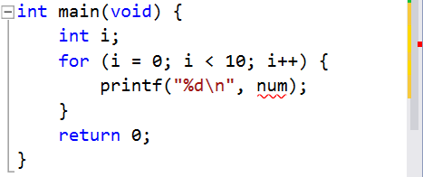
Types of Errors – syntax errors
Type 1. Compilation/Syntax Errors.
The errors that are detected during the compilation of the program.
Visual Studio can highlight these errors for you.
Move your mouse cursor over the squiggly red line to get more info about the error.
The red bar indicates that there is an error in this file.
Note: Sometimes the errors may appear before the indicated line.

Slide 4
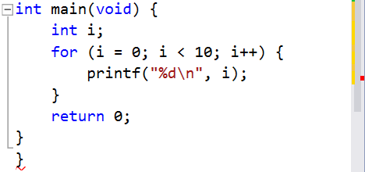
Types of Errors – syntax errors
Type 1. Compilation/Syntax Errors.
Common syntax errors:
Duplicate variable names
Missing semi-colons ;
Mismatched braces { }
This is called a dangling brace.

Slide 5
Types of Errors – run-time errors
Type 2. Run-Time Errors.
The errors occur while the program is running and cause the program to crash.
Common run-time errors:
Division by zero
Array index out of bound
The consequence of the array index out of bound error is unpredictable;
The program may crash (run-time errors), or
Some variables may get modified unknowingly (the program does not crash).
1
2
3
4
int a, b;
a = 3;
b = 0;
printf("%d\n", a / b);
1
2
3
int array[10] = { 0 };
array[10] = 50;
printf("%d\n", array[1000]);

Slide 6
Types of Errors – logical errors
Type 3. Logical Errors: the result is unexpected!
Not syntax errors or run-time errors.
i.e., the program can be compiled and executed successfully.
But, the program logic is wrong.
Source of errors: (1) Typo.
Use %d instead of %lf when the variable is of type double.
1
2
3
4
double a;
scanf("%d", &a);
if (a = 1)
...
Use = instead of == when checking for equality.

Slide 7
Types of Errors – logical errors
Source of errors: (2) Incorrect program logic.
This is the most frustrating moment!
Because we usually spend most of the programming time in discovering where the error is.
Don’t give up yet!
We have systematic way to locate logical bugs.

Slide 8
Outline
Types of Errors
Compilation/Syntax errors
Run-Time errors
Logical errors
Debugging techniques to locate logical errors
Using Debugger in Visual Studio

Slide 9
How to locate a logical error?
The output of this program is incorrect.
How should we approach to find the bug?
1
2
3
4
5
6
7
8
9
101112
// A program to convert temperature in degree Fahrenheit
// to equivalent degrees in Celsius and Kelvin.
double F, C, K; // Fahrenheit, Celsius, Kelvin
scanf("%lf", &F);
C = 5 / 9 * (F – 32);
K = C + 273.15;
printf("%.2lfF = %.2lfC = %.2lfK\n", F, C, K);

Slide 10
How to locate a logical error?
Every statement computes in the following manners
Base its computation on the value of some variable(s)
Update the value of some variable(s)
1
2
3
4
5
6
7
8
9
101112
// A program to convert temperature in degree Fahrenheit
// to equivalent degrees in Celsius and Kelvin.
double F, C, K; // Fahrenheit, Celsius, Kelvin
scanf("%lf", &F);
C = 5 / 9 * (F – 32);
K = C + 273.15;
printf("%.2lfF = %.2lfC = %.2lfK\n", F, C, K);
Use the value of F to compute, and update the value of C.

Slide 11
How to locate a logical error?
If a variable is assigned a wrongly computed value, subsequent computations will likely produce wrong results.
1
2
3
4
5
6
7
8
9
101112
// A program to convert temperature in degree Fahrenheit
// to equivalent degrees in Celsius and Kelvin.
double F, C, K; // Fahrenheit, Celsius, Kelvin
scanf("%lf", &F);
C = 5 / 9 * (F – 32);
K = C + 273.15;
printf("%.2lfF = %.2lfC = %.2lfK\n", F, C, K);
If C is assigned a wrong value here, then subsequently the value of K and the output will be affected.
How do we find out if C's value is wrong?

Slide 12
How to locate a logical error?
Variables usually hold some clues to the bug.
One way to inspect variables is to output their values.
1
2
3
4
5
6
7
8
9
101112
// A program to convert temperature in degree Fahrenheit
// to equivalent degrees in Celsius and Kelvin.
double F, C, K; // Fahrenheit, Celsius, Kelvin
scanf("%lf", &F);
C = 5 / 9 * (F – 32);
printf("DEBUG: C = %.2lf\n", C); // Check C's value
K = C + 273.15;
printf("%.2lfF = %.2lfC = %.2lfK\n", F, C, K);

Slide 13
Steps in locating logical errors
Insert “print” statements to important locations of a selected range of problematic codes.
Print out values of important variables.
Can you see unexpected values?
Narrow down the range of problematic codes.
YES
NO
NO
Can you locate the bug?
Need to print more variables out.
YES

Slide 14
Outline
Types of Errors
Compilation/Syntax errors
Run-Time errors
Logical errors
Debugging techniques to locate logical errors
Using Debugger in Visual Studio (Self-Study)

Slide 15
Start with/without Debugging
In the menu on the top, choose “DEBUG”
Start Debugging (F5)
Run the program in debug mode.
The program can be paused in the middle.
After the execution of the program, the console window will be closed immediately.
Start Without Debugging (Ctrl+F5)
The program runs normally.
After the execution of the program, the console window will pause and show “Press any key to continue . . .”.

Slide 16
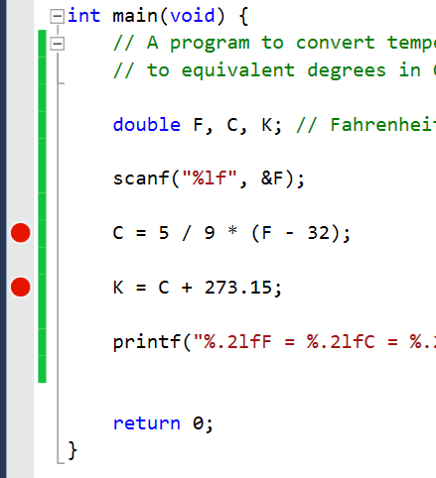
Setting the Breakpoints
A breakpoint typically represents a location (usually a line of code) where an executing program is paused.
To toggle (set or remove) a breakpoint at a line of code, click at the spot in the left grey area next to the line in the editing window.
A small red circle indicates that a break point is set at that line.
Multiple breaks points are allowed.

Slide 17
Inspecting Values of Variables
When a program is paused, we can view the values of the variables through:
“Autos” window
View variables that are related to the current statement
“Locals” window
View variables in the current scope
“Watch” window
View variables that are manually added into this window

Slide 18
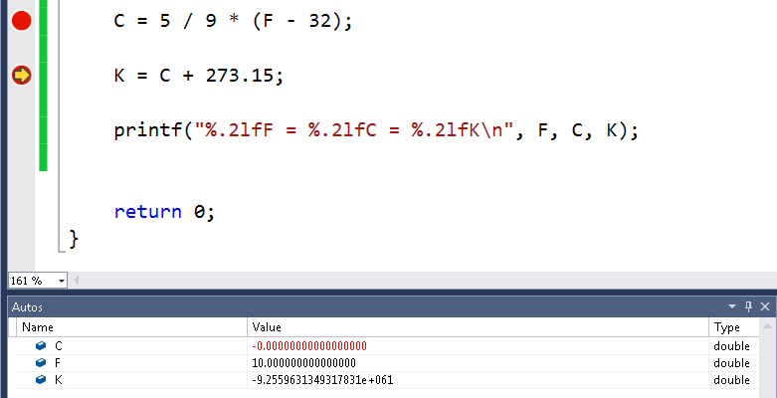
Inspecting Values of Variables
Values of C, F, and K just before the execution of “K = C + 273.15;”

Slide 19
In Between Breakpoints
When we want to continue running the program, we can use
Continue (F5)
Continue the execution until the next breakpoint is encountered.
Step Over (F10)
Execute one line of code and pause.
Step Into (F11)
Similar to Step Over if the line of code does not involve a function call.
But if the line of code involves a function call, go into the function if possible and pause.
Step Out (Shift+F11)
Similar to Continue but it will also pause just after returning from a function.

Slide 20
Stop and Restart
Stop Debugging (Shift+F5)
Stop debugging the program.
Restart (Ctrl+Shift+F5)
Restart the program.

